Slide 1


Multi-layer provenance framework for job distributed system
Quan Zhou
quzhou@indiana.edu
Indiana University Bloomington
April 4, 2014

Slide 2
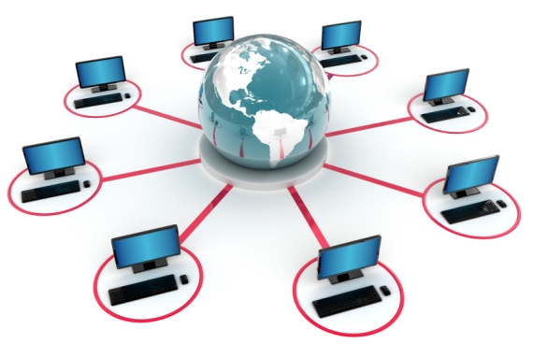
Motivation
Global information is expensive in distributed environment
Multi-layer software stacks and distributed knowledge
Massive overhead to infer correlation between events or activities in varied layers
Enable provenance-based failure tracing and data lineage tracking
Data management requirements in data driven scientific workflows
Failure tracing and diagnose requirements in highly distributed system
Examine the quality and usefulness of provenance that can be collected by middleware and platform provenance only
Applications, services
Operating System
Computer and network hardware
Middleware

Slide 3
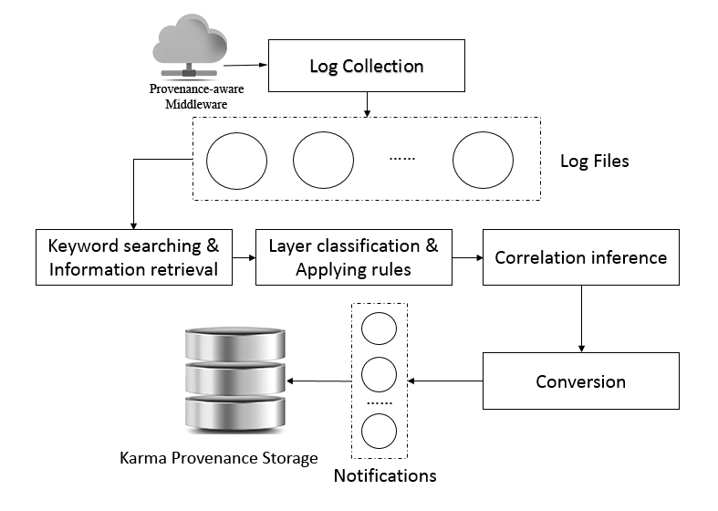
Methodology
Provenance-aware middleware
Middleware wrapper script
Provenance adaptor
Log collection
Keyword searching
Information retrieval
Correlation inference engine
Timestamp similarity
Data flow similarity
Provenance storage
Raw data to provenance conversion
Karma Provenance Repository

Slide 4
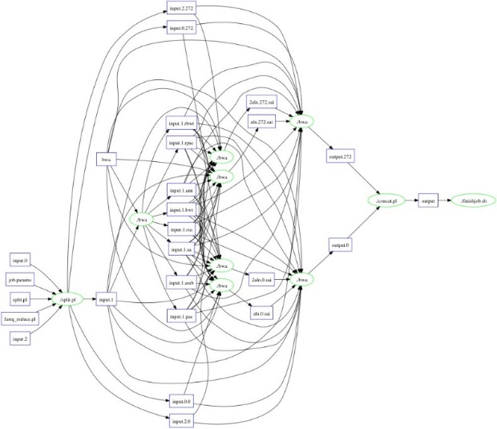
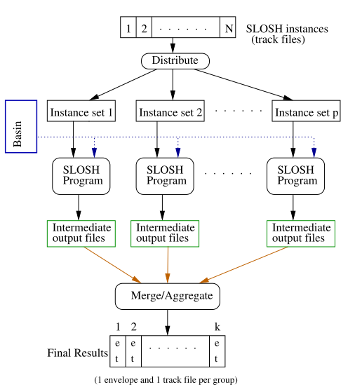
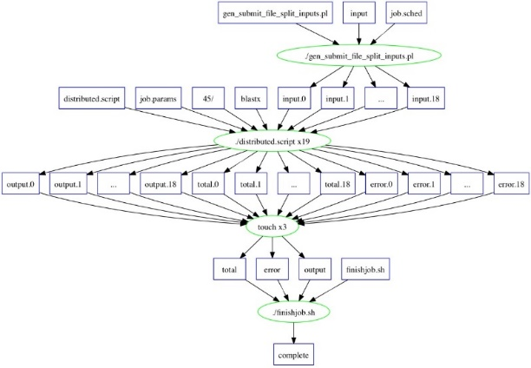
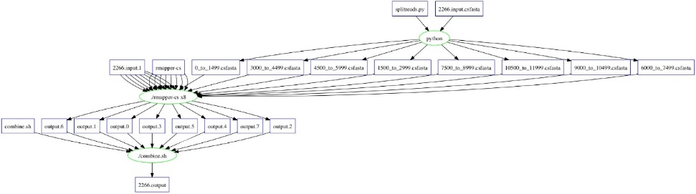
Application Cases
Fig. 1 the Sea, Lake and Overland Surge from Hurricanes (SLOSH) model By NOAA
Fig. 2 BWA workflow (Input size: 6.5 GB; Used workers: 10)
Fig. 3 BLAST workflow (Input size: 8.4 GB; Used workers: 10)
Fig. 4 Shrimp workflow (Input size:675 MB; Used workers: 10)

Slide 5
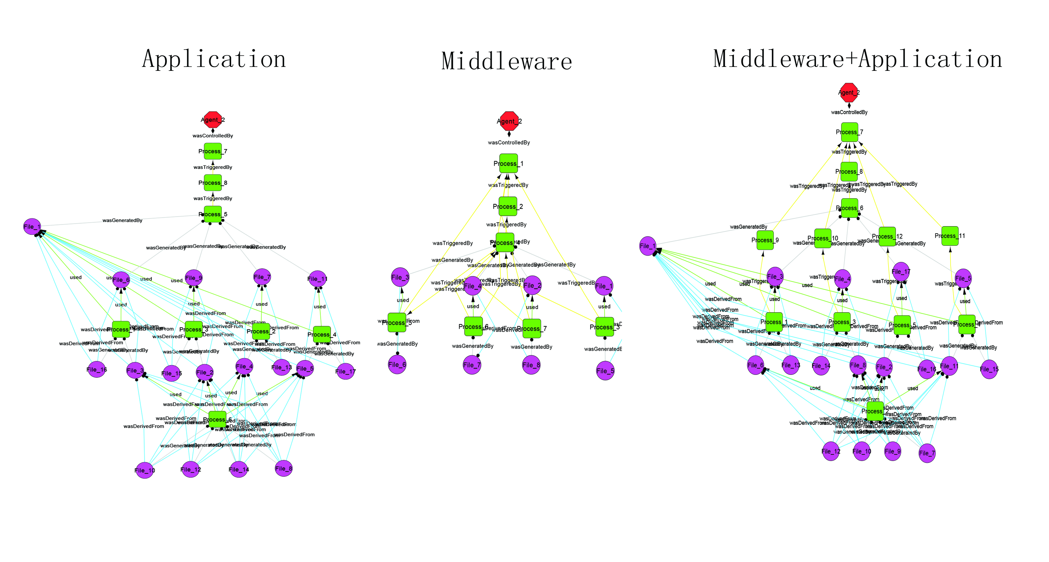
Evaluation
Multi-layer provenance events correlation inference

Slide 6
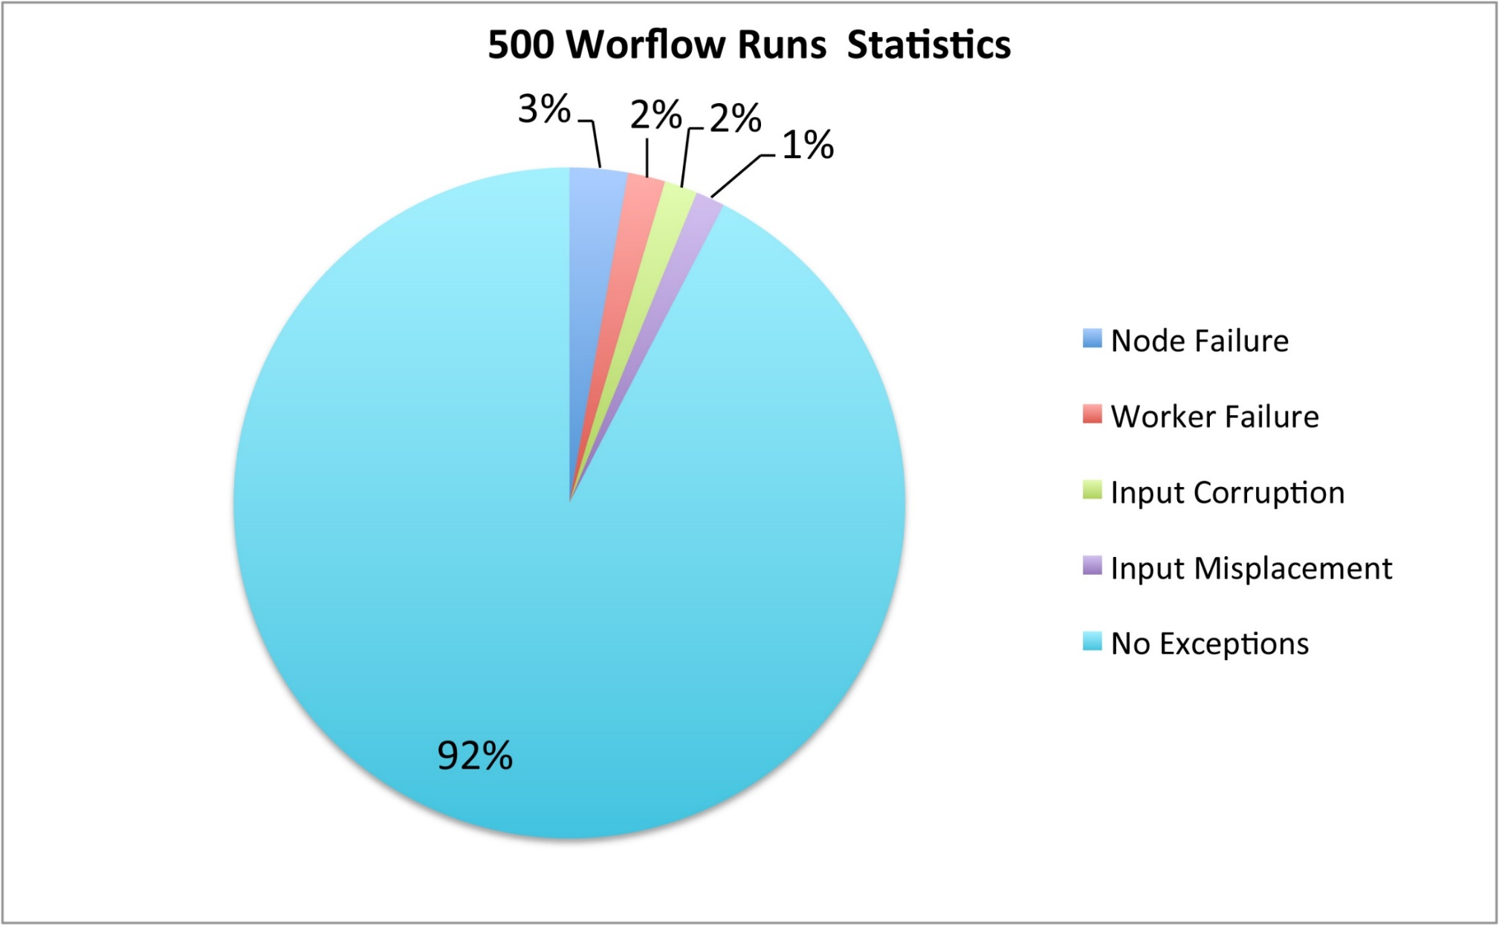

Slide 7
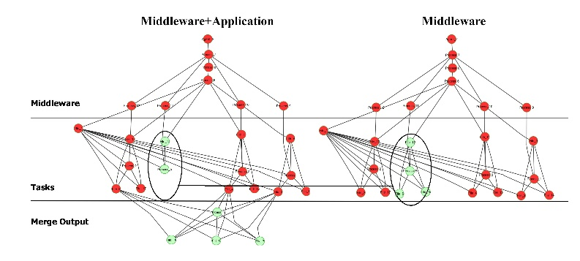
Evaluation
Provenance-based failure tracing and data lineage tracking
Failure Detection:
Input Misplacement

Slide 8
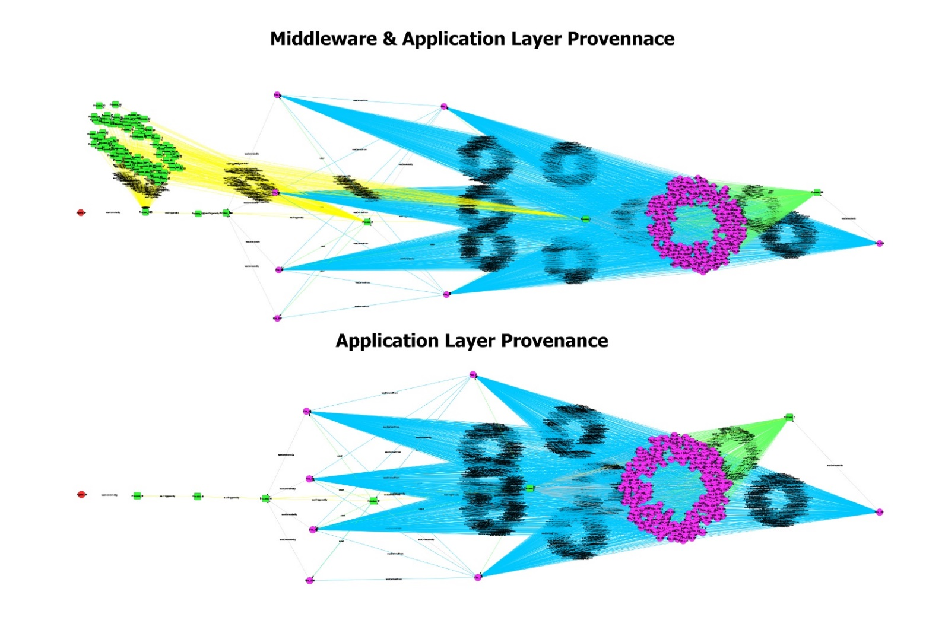
Evaluation
Generalizing multi-layer provenance framework

Slide 9
Ongoing and Future Work to handle BigData in distributed environment
Quality metrics for provenance data quality assessment
Adding more configurability and portability for provenance identification and collection mechanism
Seeking more application cases for generalization

Slide 10
Acknowledgements
This work is funded in part by the National Science Foundation OCI 1148359. We thank Craig Mattocks of the National Hurricane Center, Miami, Florida for his expertise with the Sea, Lake and Overland Surges from Hurricanes (SLOSH) model and Doug Thain of Notre Dame for sharing datasets that run on WorkQueue.

